Slide 1
Hotel Booking Cancellation Modeling
William Lee
May 2026

Slide 2
Summary of deck contents
01
02
03
Data Cleaning
Exploratory Data Analysis
Models
kNN
Log Regression
Cat Boost
Slide 5
Slide 6
Slide 8

Slide 3

Welcome
to the team
Date
William Lee

Slide 4
Will a guest cancel?
We want to predict whether a hotel guest will cancel based on a variety of factors.
We used hotel data, which includes features such as average daily rate, deposit type, hotel type, and lead time.

Slide 5
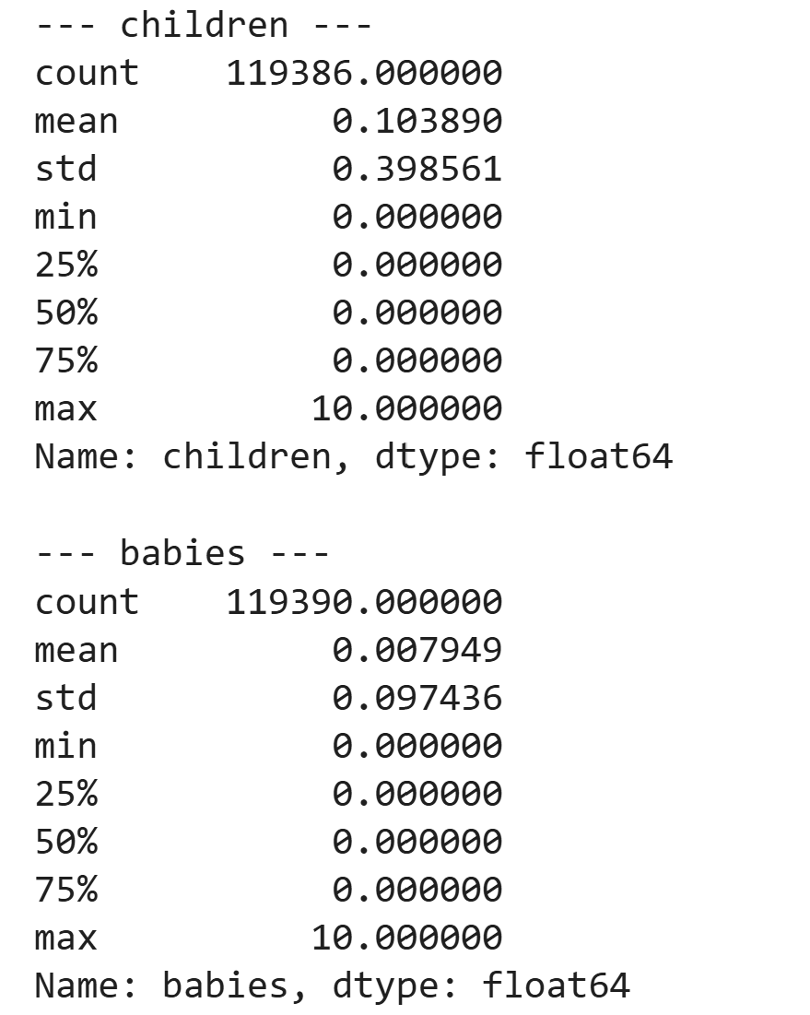
Data Cleaning
Cleaned the data for outliers:
ADR == 0
ADR > 1000
adults == children == 0
children == 10
babies >8
Removed ~2000 entries

Slide 6
Exploratory Data Analysis
Data shape: 117391 x 32
Split:
Non Cancel: 73386
Cancel: 44005

Slide 7
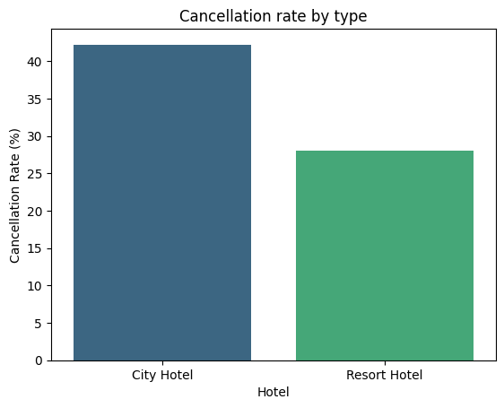
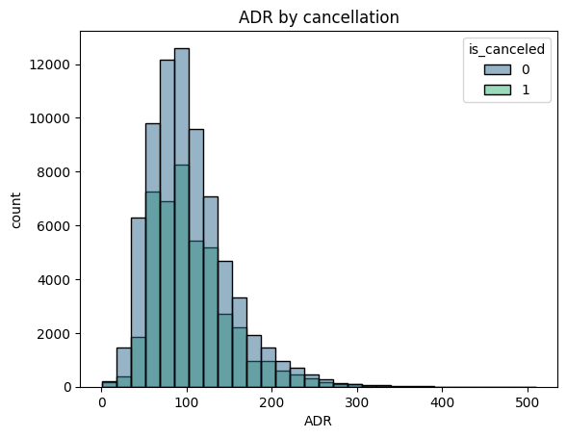
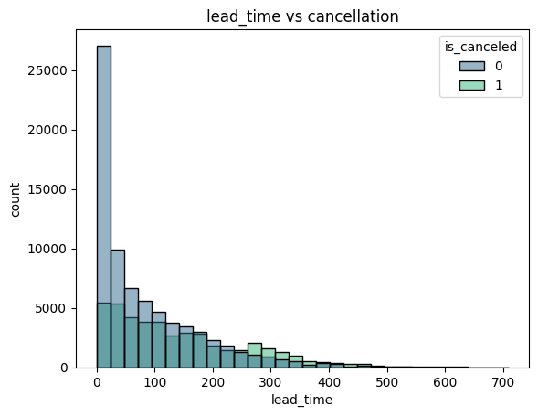
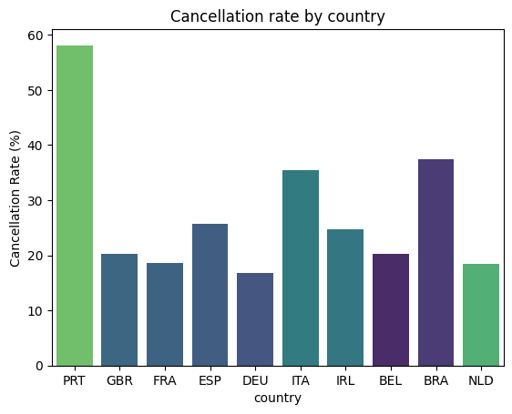
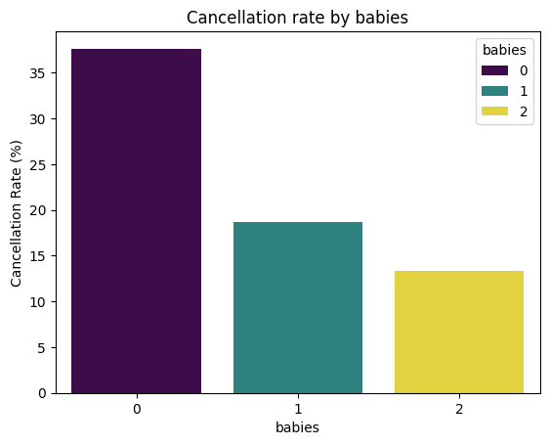
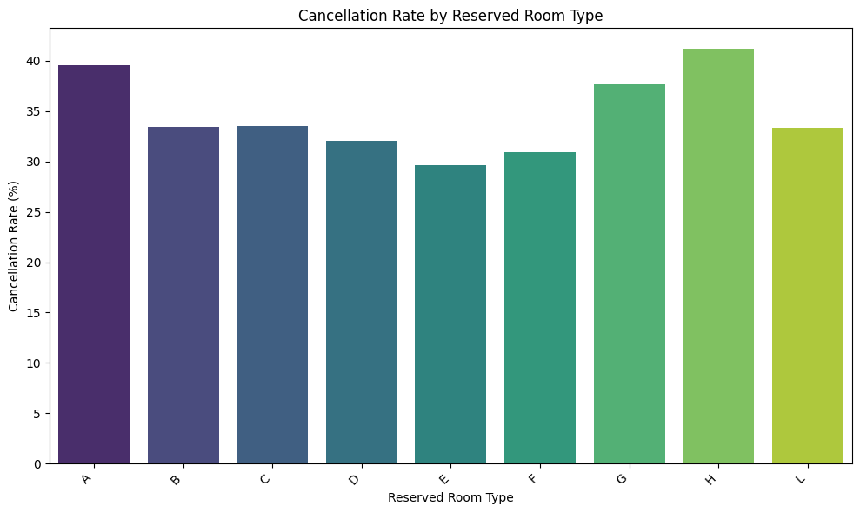
Exploratory Data Analysis

Slide 8
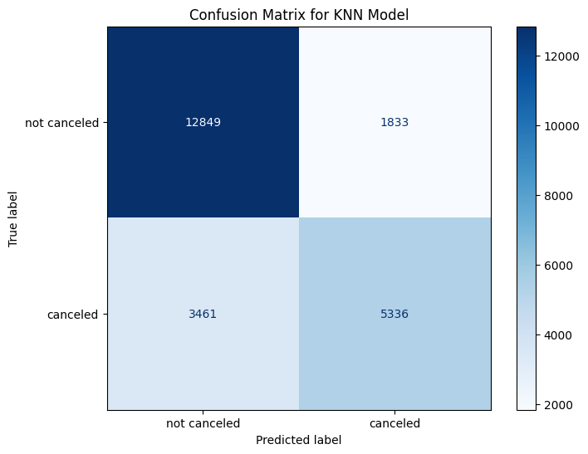
K Nearest Neighbor
We applied kNN with the features ADR, lead_time, and babies.
Used scaling and weights
K = 101
Results:
F1-score: 77%

Slide 9
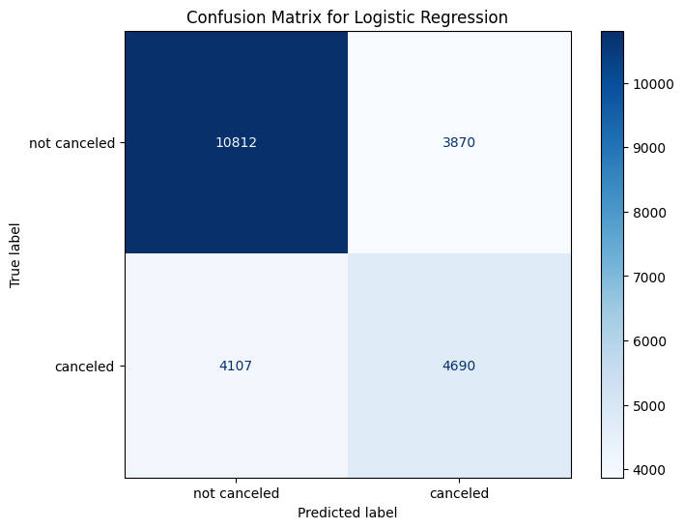
Logistic Regression
We used Logistic Regression
Features ADR, babies, previous_cancellations, and lead_time
Used scaling and weights
Results:
67%

Slide 10
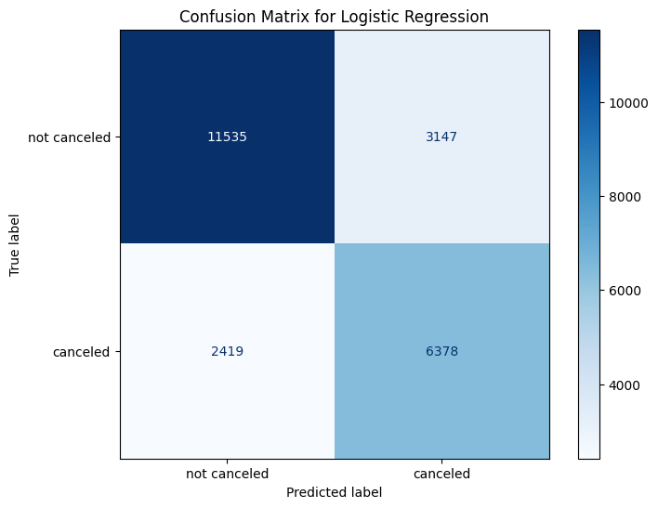
CatBoost
We applied CatBoost with the features country, hotel, reserved_room_type, arrival_date_month, adr, lead_time, and babies
Used weights
Results:
F1-score: 76%

